Slide 1

Fundamental of ciruits
Current, ohms’law, resistor, capacitor, Series and parallel sircuits, KVL,KCL PROBLEMS

Slide 2
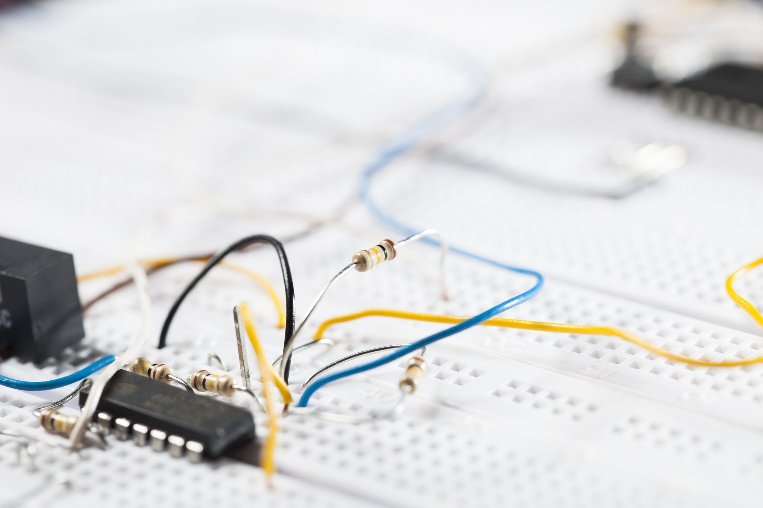
INTRODUCTION
Basic definitions:
Circuit :An arrangement or connection of circuit devices and components to perform a specific objective. (Combination of electronic parts, wires connected between power sources).

Slide 3
Basic Definitions
Current (I):The rate of flow of electrons through a conductor or component; measured in amperes. The symbol (I) stands for intensity of the electron flow.
Voltage (V): Same as emf. The force or electrical pressure that has the potential to cause electron flow in a circuit.
Voltage divider: A series circuit that divides voltage.

Slide 4

Basic Definitions
Voltage drop: The difference in potential between two points caused by current flow through a component.
Voltmeter: An instrument used to measure voltage.
Volt (V):The unit by which an electromotive force or voltage is measured. Named for Alessandro Volta, the Italian physicist who invented the first electric battery (1800).

Slide 5
Active Components
Active Components
The devices are used for the amplification, rectification or the change of energy from one to another. For example , Transistor, diode , LED that converts electrical energy into light energy.

Slide 6

Passive components
Passive components
The device can be used to complete a circuit with voltage and current sources and active components. For example resistors. Capacitor, inductor, and transformers.These components are called passive because they by themselves are not capable of amplify signals or processing an electric signal

Slide 7
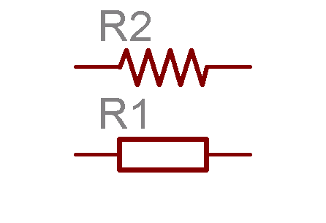


Resistor Symbol
Notes:
7

Slide 8
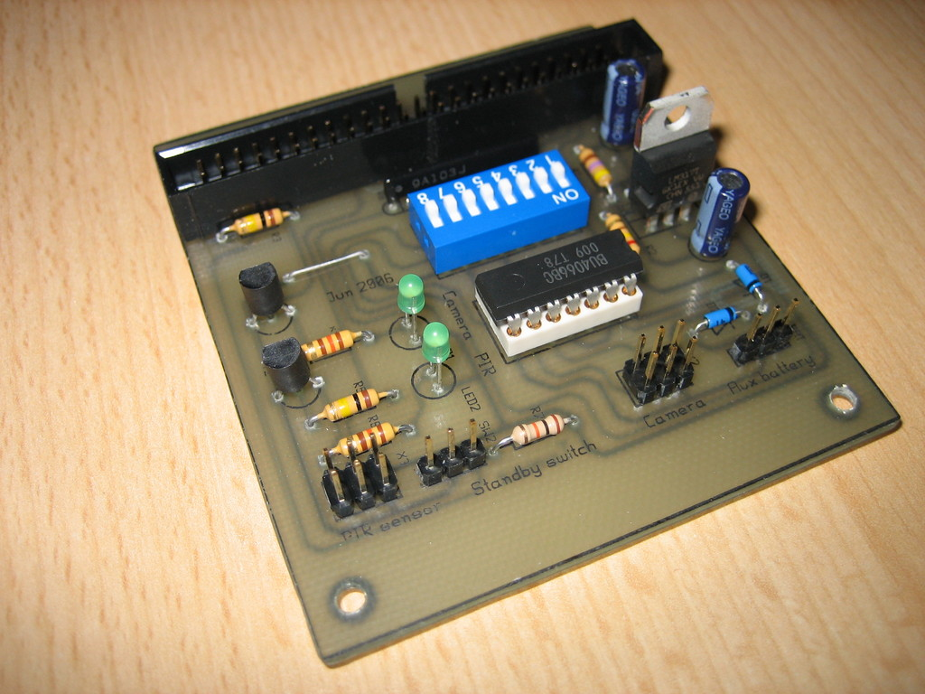
Resistors on PCB
Resistors
(axial components
with color bands

Slide 9
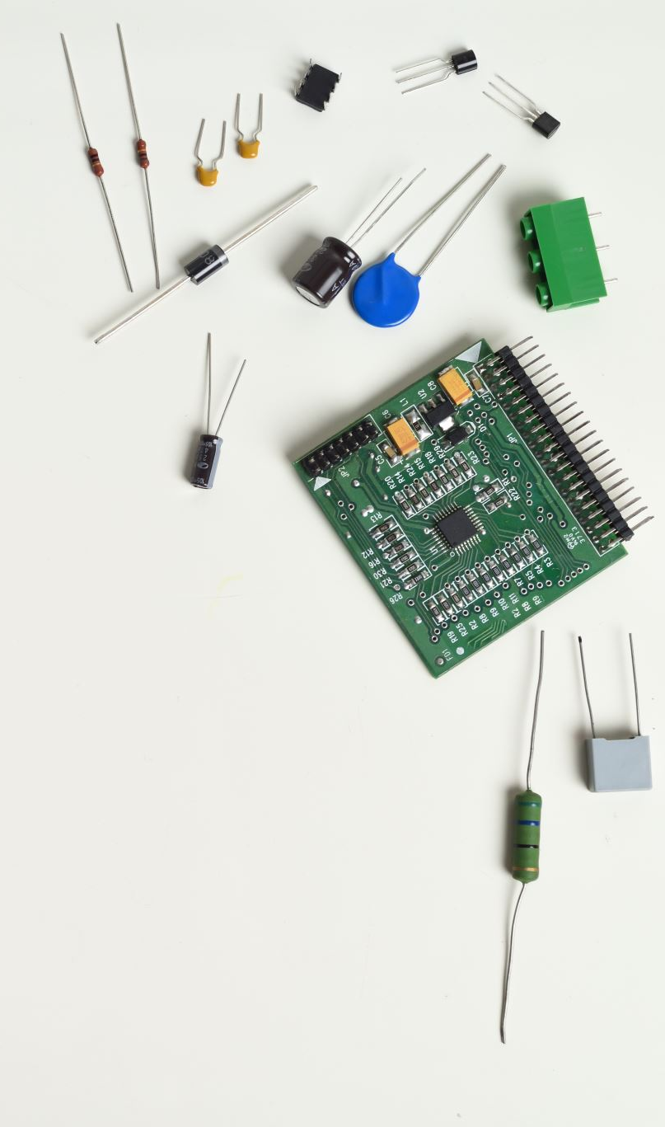
Uses of Resistors
The uses and applications of a resistor within an electrical or electronic circuit are vast and varied with virtually every electronic circuit ever designed using one or more types of resistor.

Slide 10

Series circuits CH 5 :
Problem solving of resistors in series

Slide 11
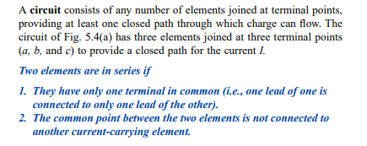
5.2 Series ciruit

Slide 12

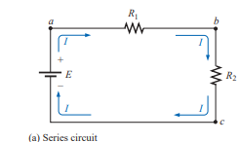
Series circuit

Slide 13



Series ciruit

Slide 14



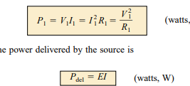

Series ciruit

Slide 15
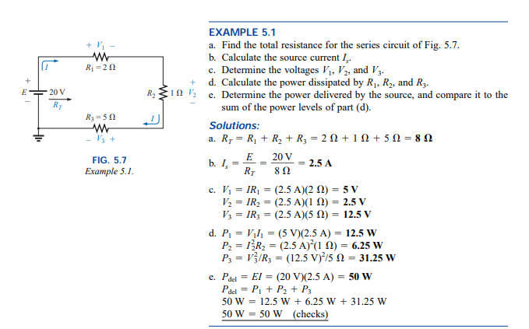

Slide 16
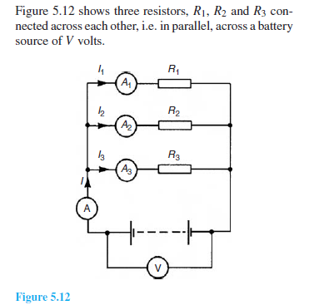
Parallel circuits

Slide 17
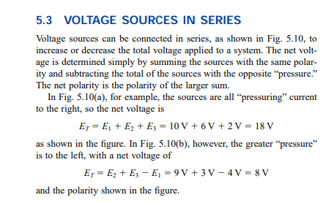

Slide 18
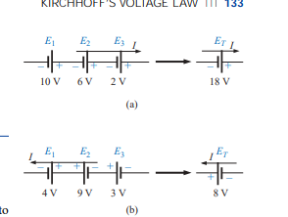

Slide 19

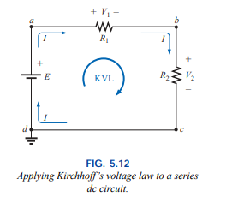

5.4 KVL

Slide 20
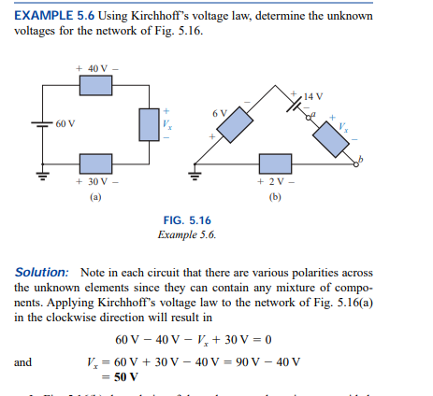


Slide 21
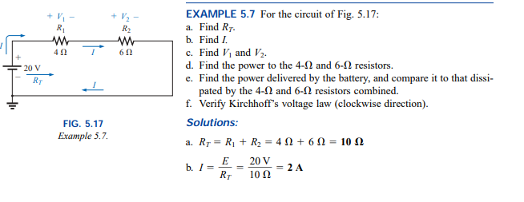

Slide 22
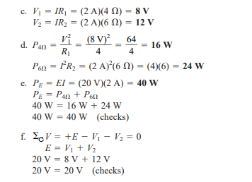

Slide 23
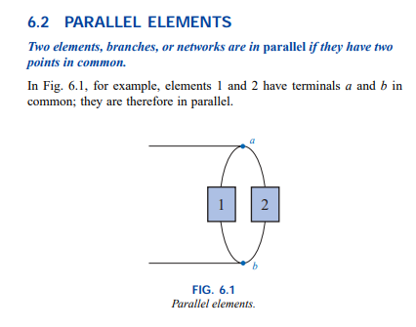

Slide 24
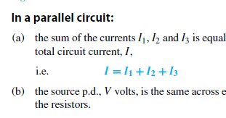
Parallel circuits

Slide 25
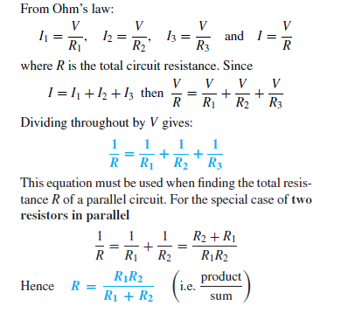
Parallel circuits

Slide 26
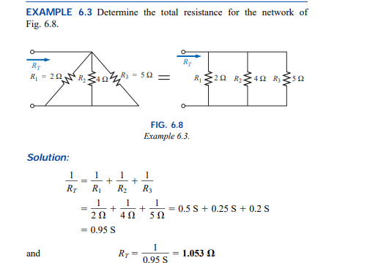

Slide 27

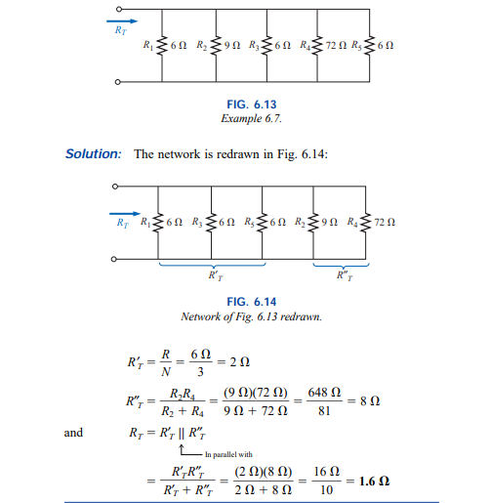

Slide 28
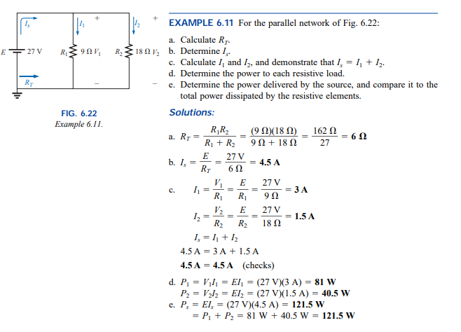

Slide 29
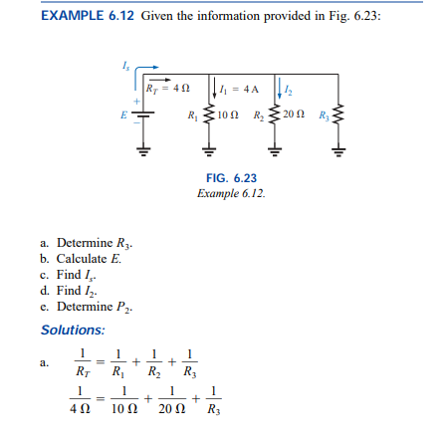

Slide 30
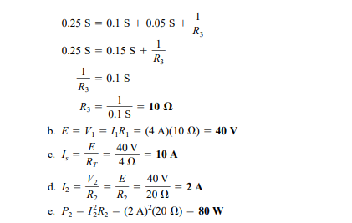

Slide 31
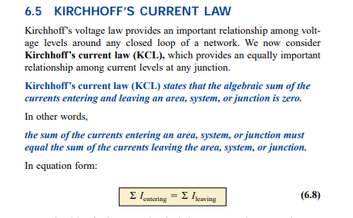

Slide 32
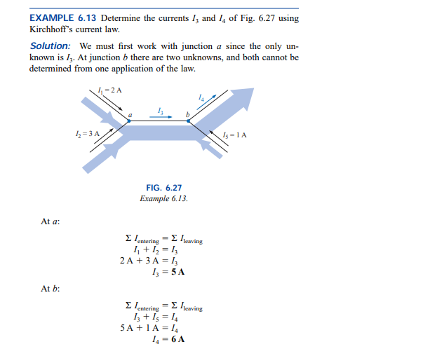

Slide 33
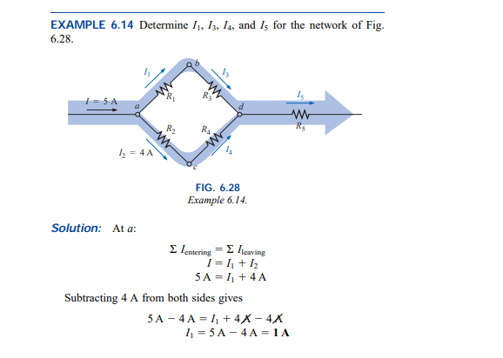

Slide 34
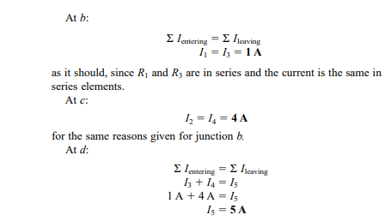

Slide 35
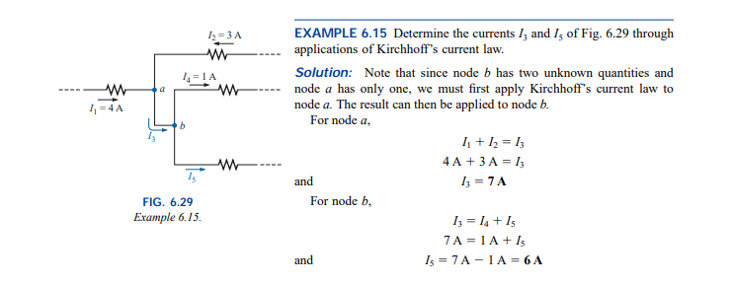

Slide 36

7.1 Series and parallel

Slide 37
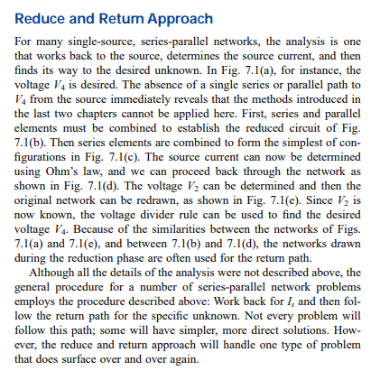

Slide 38
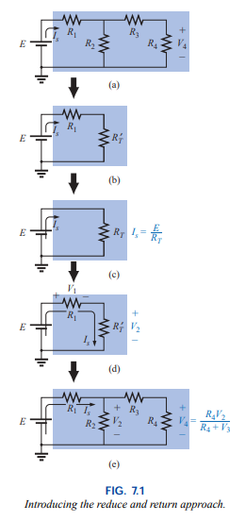

Slide 39
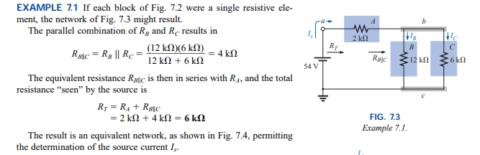

Slide 40
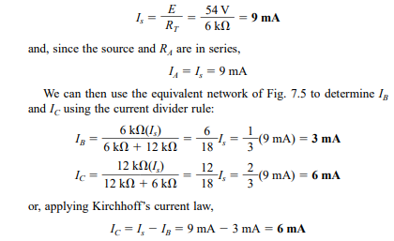

Slide 41
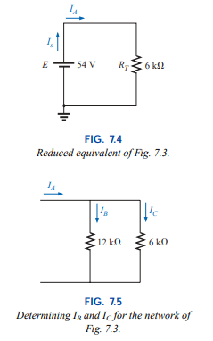

Slide 42
Problems solving
BY using KVL and KCL

Slide 43
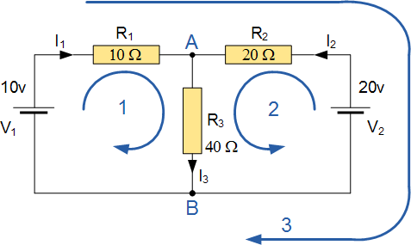
Find the current flowing in 40 ohm resistor R3

Slide 44
Solution
The circuit has 3 branches, 2 nodes (A and B) and 2 independent loops.
Using Kirchhoffs Current Law, KCL the equations are given as:
At node A : I₁ + I₂ = I₃
At node B : I₃ = I₁ + I₂
Using Kirchhoffs Voltage Law, KVL the equations are given as:
Loop 1 is given as : 10 = R₁ I₁ + R₃ I₃ = 10I₁ + 40I₃
Loop 2 is given as : 20 = R₂ I₂ + R₃ I₃ = 20I₂ + 40I₃

Slide 45
Solu.cont
Loop 3 is given as : 10 – 20 = 10I₁ – 20I₂
As I₃ is the sum of I₁ + I₂ we can rewrite the equations as;
Eq. No 1 : 10 = 10I₁ + 40(I₁ + I₂) = 50I₁ + 40I₂
Eq. No 2 : 20 = 20I₂ + 40(I₁ + I₂) = 40I₁ + 60I₂
We now have two “Simultaneous Equations” that can be reduced to give us the values of I₁ and I₂
Substitution of I₁ in terms of I₂ gives us the value of I₁ as -0.143 Amps
Substitution of I₂ in terms of I₁ gives us the value of I₂ as +0.429 Amps

Slide 46
Solu.conti.
As : I₃ = I₁ + I₂
The current flowing in resistor R₃ is given as : -0.143 + 0.429 = 0.286 Amps
and the voltage across the resistor R₃ is given as : 0.286 x 40 = 11.44 volts
The negative sign for I₁ means that the direction of current flow initially chosen was wrong, but never the less still valid. In fact, the 20v battery is charging the 10v battery.

Slide 47
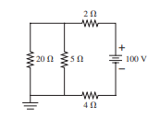
. What is the current through 20 ohm resistor?

Slide 48
